Slide 1
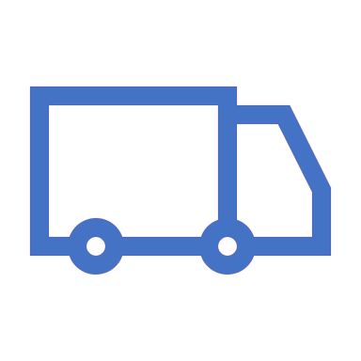
The delivery bot
Theo Gun Koh(G10)
Theo.koh@student.isb.bj.edu.cn

Slide 2

Mission statement
Track the line!
Delivery the product to final destination!
Try to make safe movement as possible as it can.
This Photo by Unknown Author is licensed under CC BY-SA

Slide 3
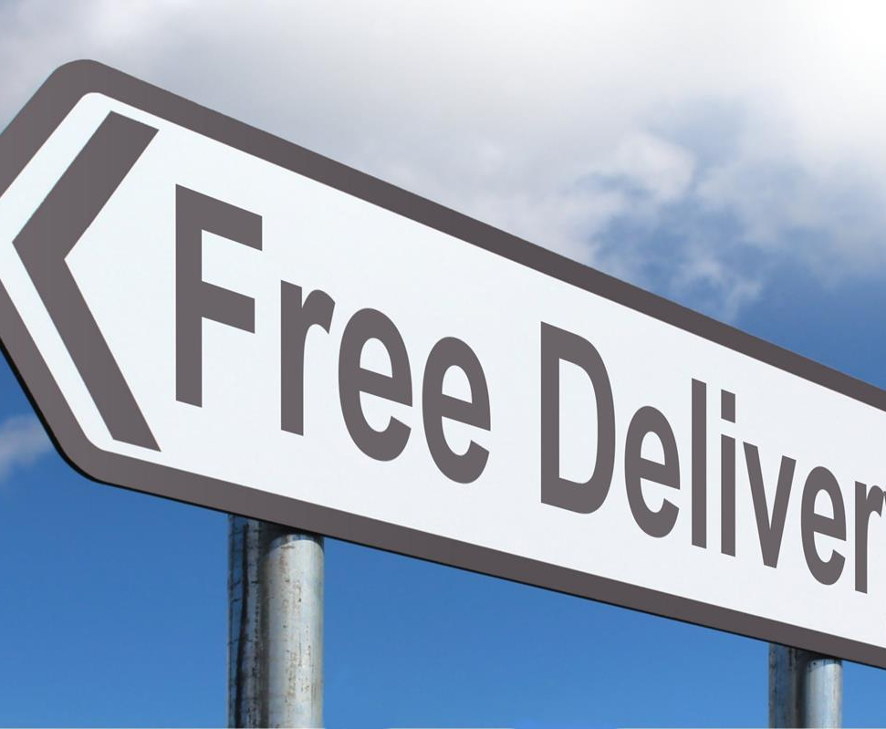
Proof of concept
The concept of my design is ‘Delivery’. Nowadays, by develop of industry lots of works are changing into
This Photo by Unknown Author is licensed under CC BY-SA

Slide 4
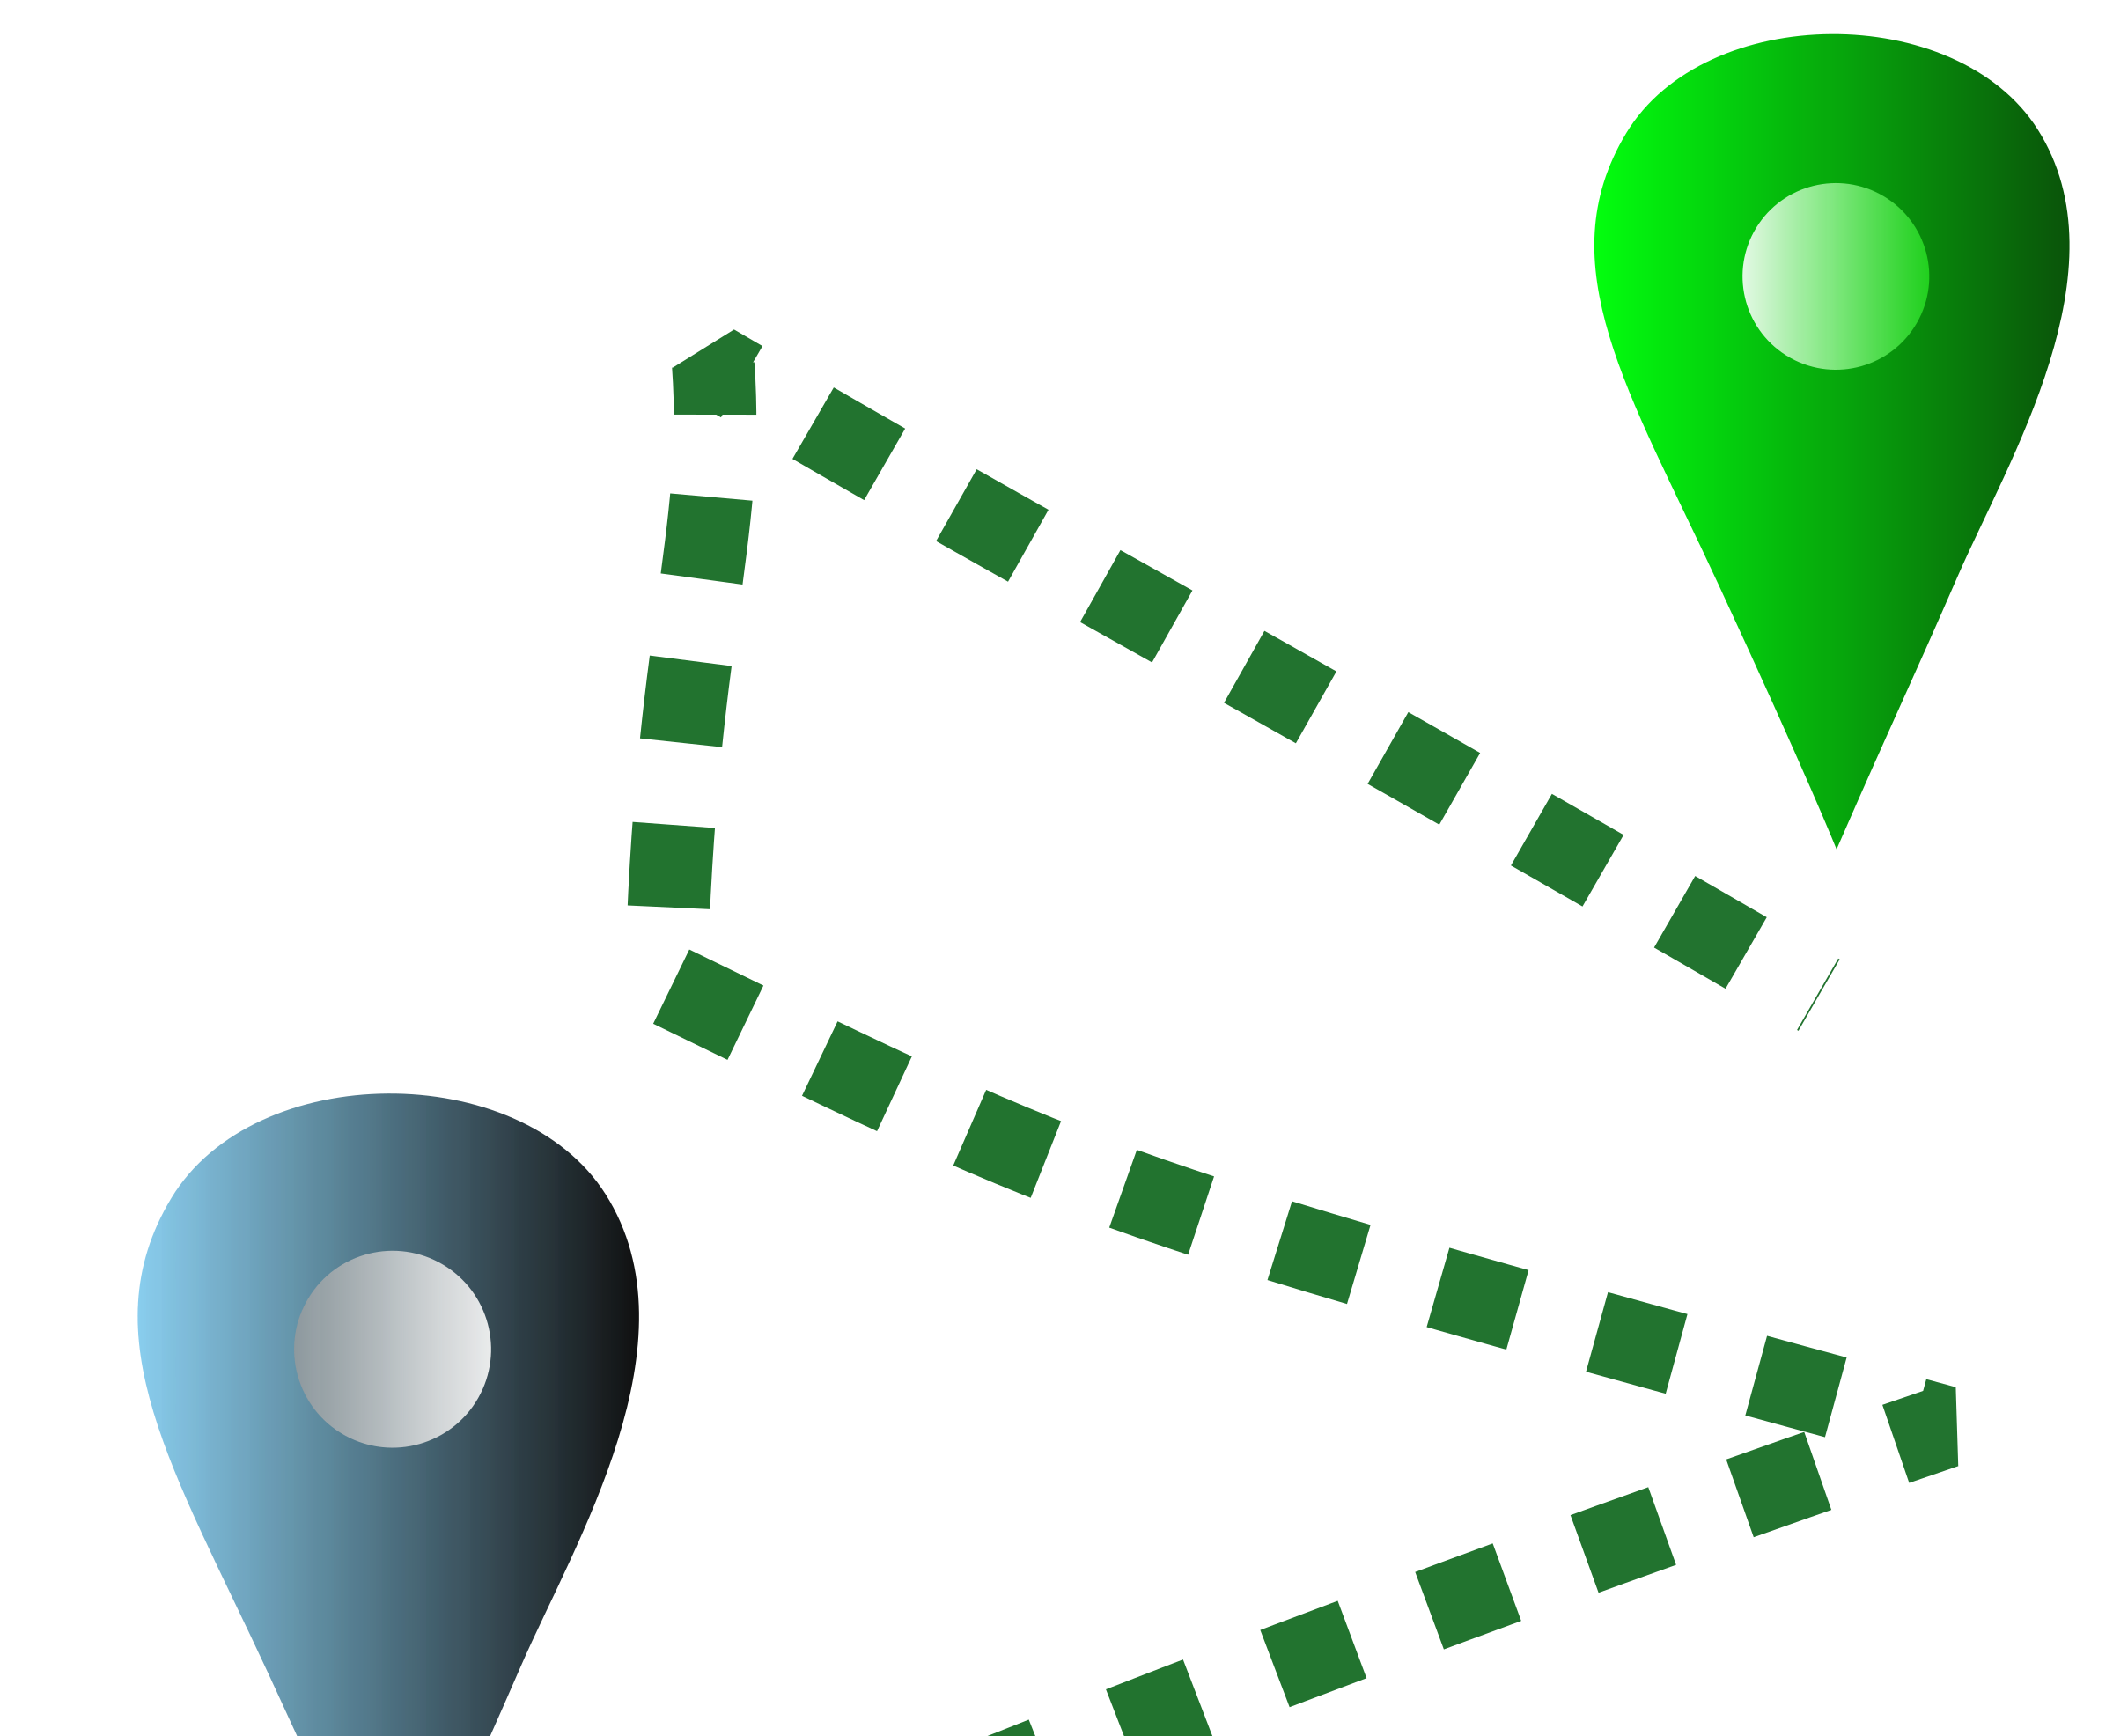
Success criteria
If ‘Delivery bot’ follows the line.
‘Delivery bot’ arrives successfully in destination.

Slide 5
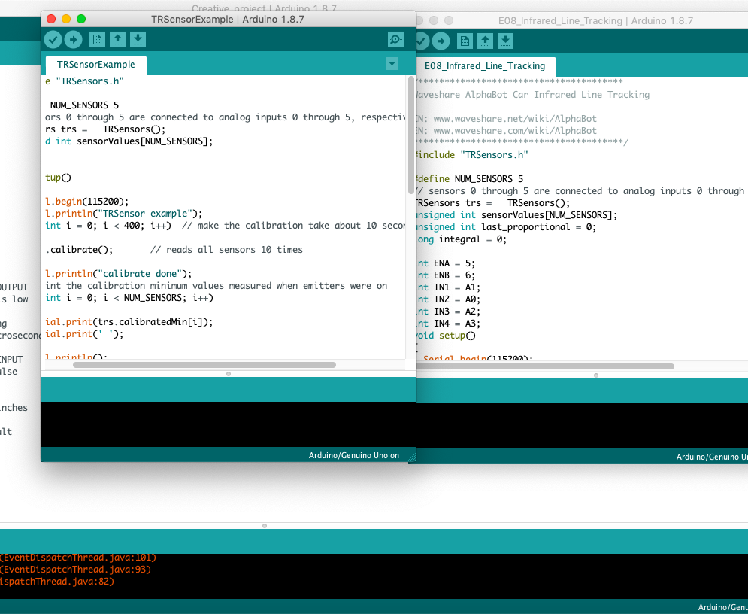
Programming

Slide 6
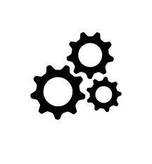
Materials
The kit of Alphabot
Laptop with Arduino
Design app(Fusion 360) for minor upgrade

Slide 7
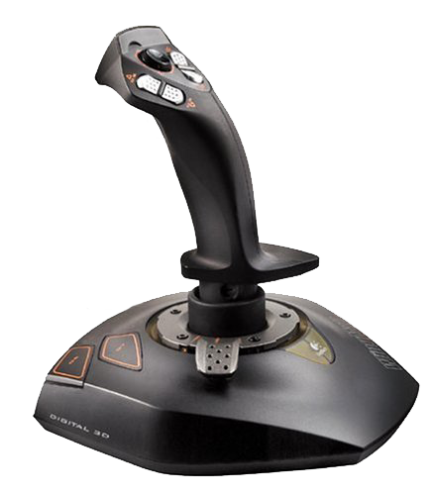
Controls/programs
The name of the program I use for programming is Arduino. This program is used to program software such as the robot's brain when the robot moves later, as a means for the user to directly give commands using the C+ language when the robot performs an action.
알 수 없는 작성자 님의 이 사진에는 CC BY-NC 라이선스가 적용됩니다.

Slide 8
The Schedule
Delivery bot
Day 1(5/10) | Day 2(5/12) | Day 3(5/14) | Day 4(5/18) | Day 5(5/20) | Day 6(5/24) | Day 7(5/26) | Day 8(5/28)
Planning & Design | Keep making an prototype | Prototype making | Programming & get feedback | Fix prototype | Add some several tracking stuff | Test ride | Test ride & submit
Try to get materials | Step: 1-5 | Step: 5-all
Start to make prototype

Slide 9
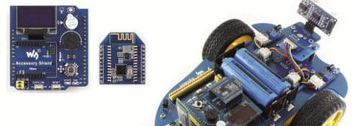
Trials
Programming the Prototype and try with the tape which color is black
Try prototype
Build final type
Try to make it run
알 수 없는 작성자 님의 이 사진에는 CC BY-SA-NC 라이선스가 적용됩니다.

Slide 10
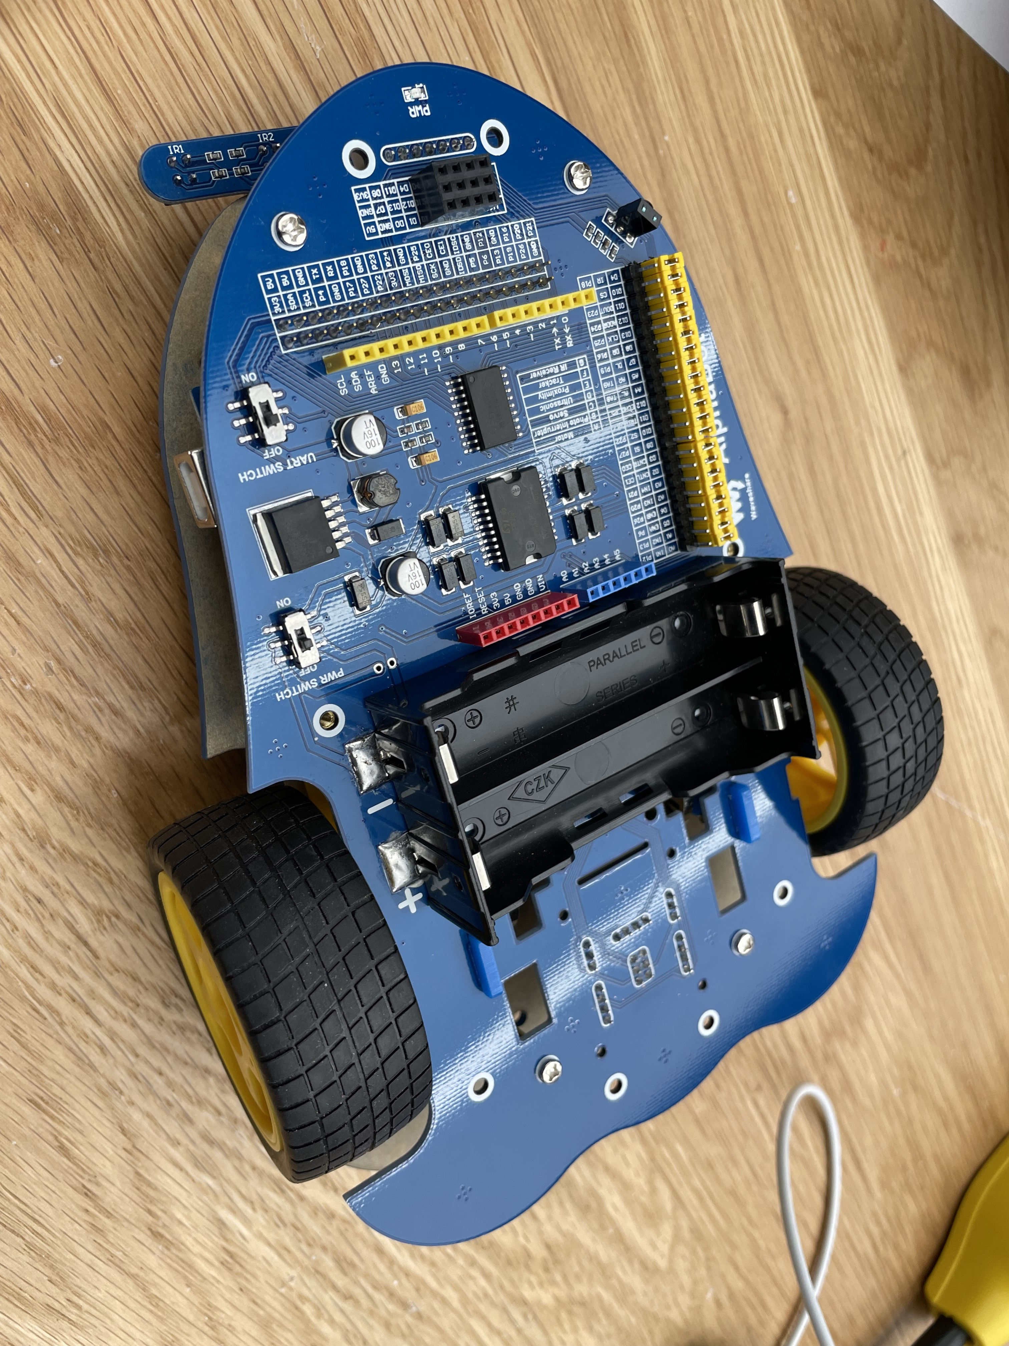
Prototype

Slide 11
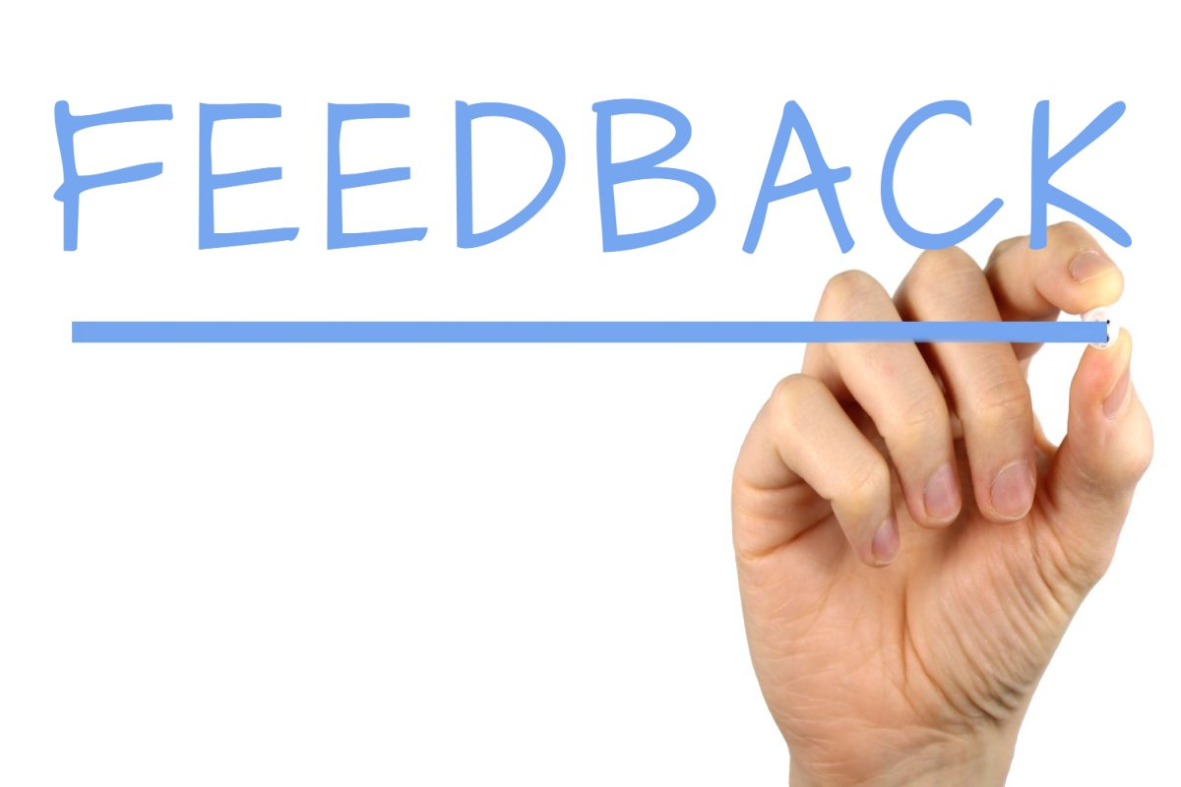
After Create
Get some feedback from people.
Use the code and search for the most fit programming of alphabot to make it move.
This Photo by Unknown Author is licensed under CC BY-SA

Slide 12

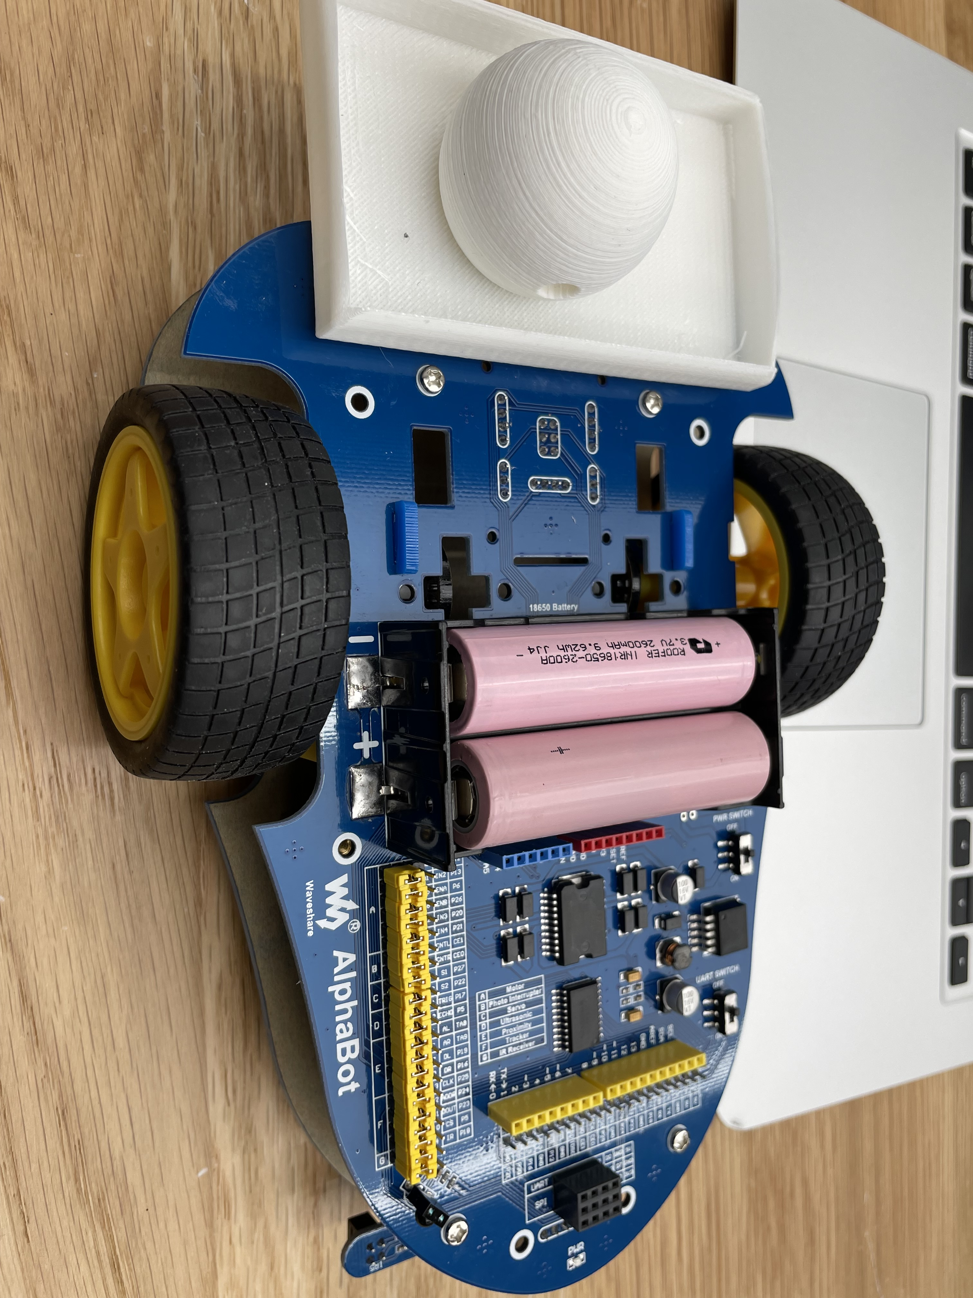
Final Type
Attach the Trunk on the Alphabot to add some luggage

